Slide 1

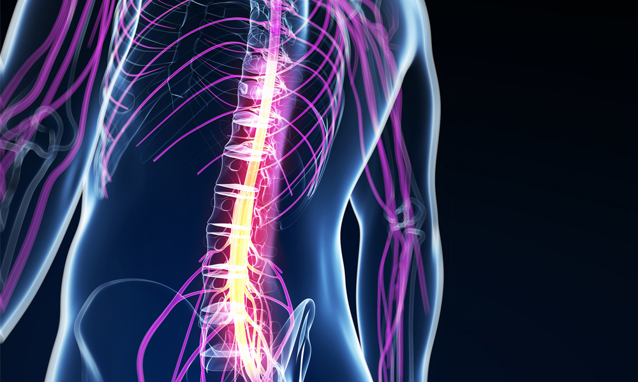
The spinal cord
Al-Farabi Kazakh National University
Higher School of Medicine
https://noticias.4medic.com.br/lesao-medular/

Slide 2
Overview of Nervous System
endocrine and nervous system maintain internal coordination
  endocrine system - communicates by means of chemical messengers (hormones) secreted into to the blood
  nervous system - employs electrical and chemical means to send messages from cell to cell
nervous system carries out its task in three basic steps:
    sense organs receive information about changes in the body and the external environment, and transmits coded messages to the spinal cord and the brain
    brain and spinal cord processes this information, relates it to past experiences, and determine what response is appropriate to the circumstances
    brain and spinal cord issue commands to muscles and gland cells to carry out such a response

Slide 3
Two Major Anatomical Subdivisions of Nervous System
central nervous system (CNS)
  brain and spinal cord enclosed in bony coverings
    enclosed by cranium and vertebral column
peripheral nervous system (PNS)
  all the nervous system except the brain and spinal cord
  composed of nerves and ganglia
    nerve – a bundle of nerve fibers (axons) wrapped in fibrous connective tissue
    ganglion – a knot-like swelling in a nerve where neuron cell bodies are concentrated

Slide 4
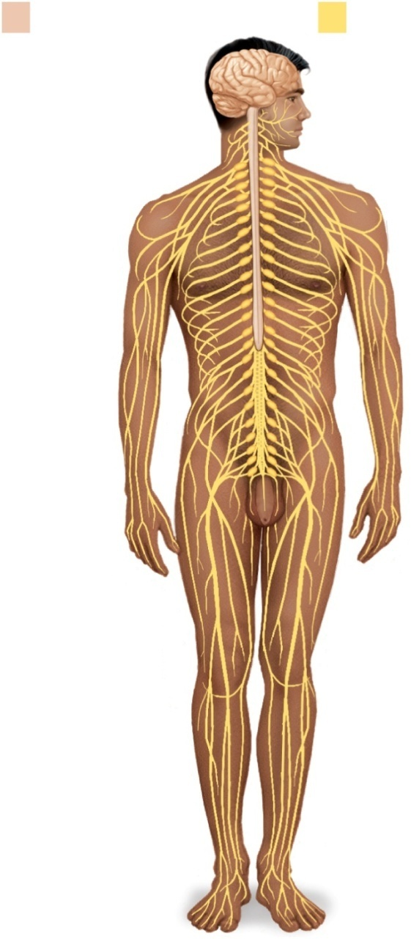
Subdivisions of Nervous System
Anatomy & Physiology: The Unity of Form and Function McGraw-Hill Education; 8th Edition
Central nervous
system (CNS)
Peripheral nervous
system (PNS)
Brain
Spinal
cord
Nerves
Ganglia
Figure 12.1

Slide 5
Sensory Divisions of PNS
sensory (afferent) division – carries sensory signals from various receptors to the CNS
  informs the CNS of stimuli within or around the body
  somatic sensory division – carries signals from receptors in the skin, muscles, bones, and joints
  visceral sensory division – carries signals from the viscera of the thoracic and abdominal cavities
    heart, lungs, stomach, and urinary bladder

Slide 6
Motor Divisions of PNS
motor (efferent) division – carries signals from the CNS to gland and muscle cells that carry out the body’s response
    effectors – cells and organs that respond to commands from the CNS
  somatic motor division – carries signals to skeletal muscles
    output produces muscular contraction as well as somatic reflexes – involuntary muscle contractions
  visceral motor division (autonomic nervous system) - carries signals to glands, cardiac muscle, and smooth muscle
    involuntary, and responses of this system and its receptors are visceral reflexes
    sympathetic division
      tends to arouse body for action
      accelerating heart beat and respiration, while inhibiting digestive and urinary systems
    parasympathetic division
      tends to have calming effect
      slows heart rate and breathing
      stimulates digestive and urinary systems

Slide 7
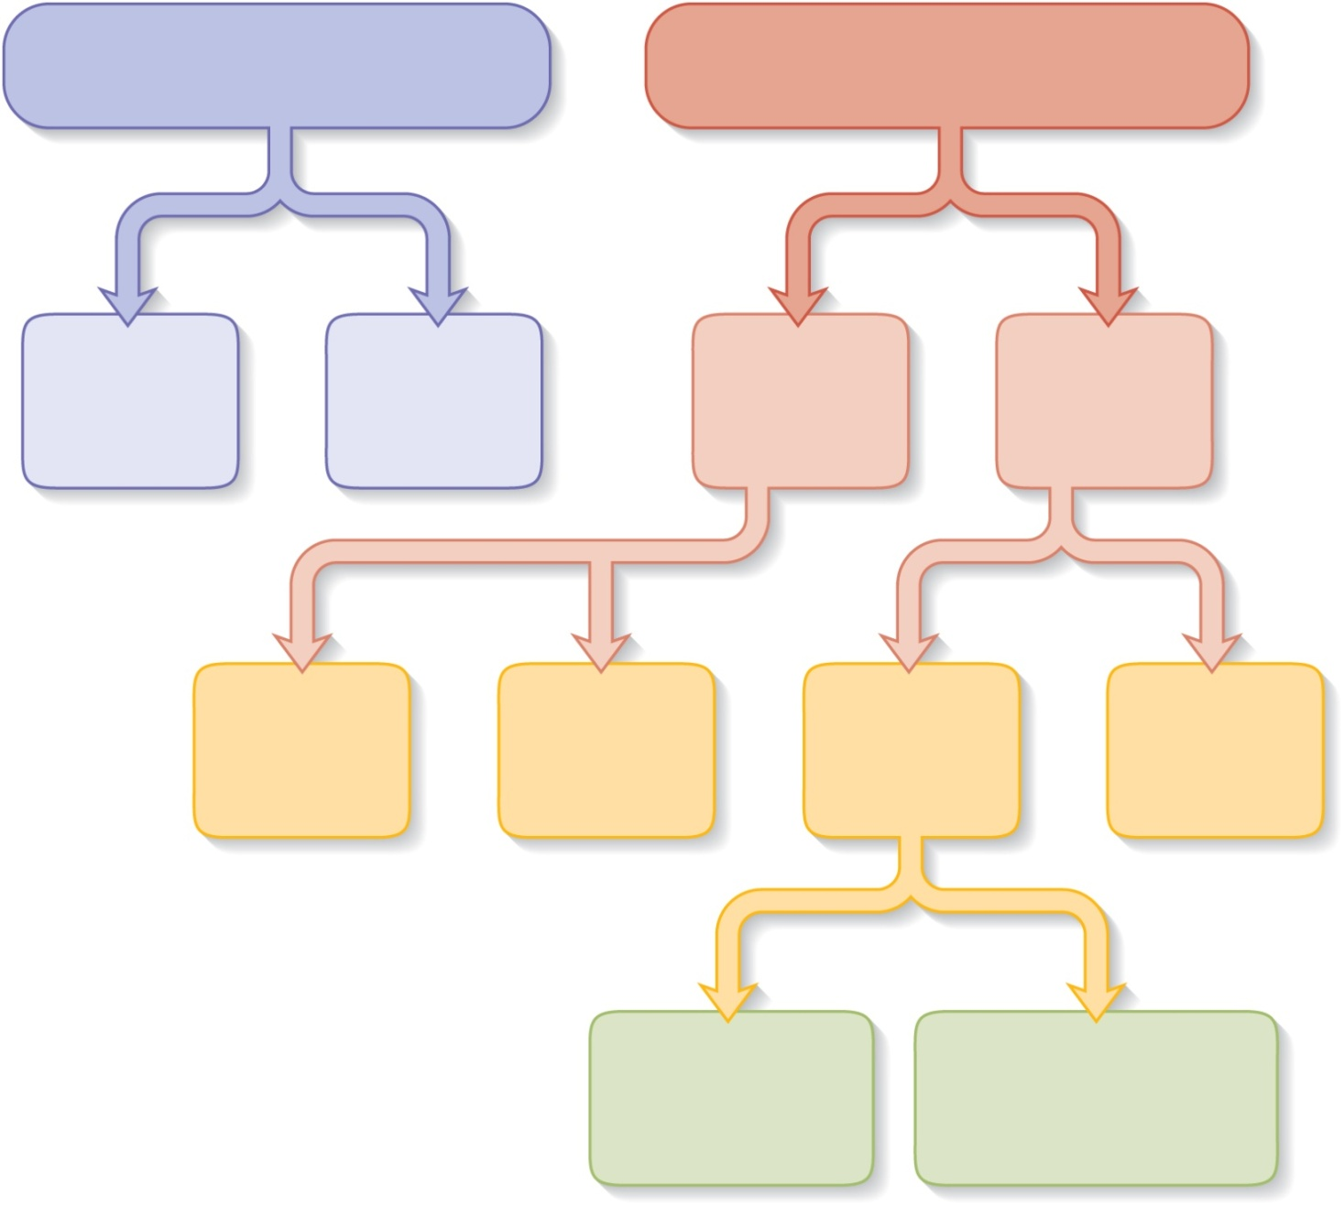
Subdivisions of Nervous System
Anatomy & Physiology: The Unity of Form and Function McGraw-Hill Education; 8th Edition
Central nervous system
Peripheral nervous system
Brain
Spinal
cord
Sensory
division
Motor
division
Visceral
sensory
division
Somatic
sensory
division
Visceral
motor
division
Somatic
motor
division
Figure 12.2
Sympathetic
division
Parasympathetic
division

Slide 8
LEARNING OUTCOMES
As a result of the lesson you will be able to:
Identify the parts of spinal cord in the model;
Identify the innervation of the spinal cord’s branches;
State the three principal functions of the spinal cord;
Describe its gross and microscopic structure;
Trace the pathways followed by nerve signals travelling up and down the spinal cord.

Slide 9
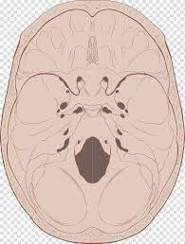
1. Identify the parts of spinal cord in the model
The spinal cord is an organ of the central nervous system located in the vertebral canal.
It has cylinder-like shape and arises from the brainstem at the foramen magnum of the skull.
At the top it goes into medulla oblongata
https://favpng.com/png_view/image-of-skull-base-of-skull-foramen-magnum-bone-anatomy-png/St3Nvg22

Slide 10
In adults, it averages about 45 cm long and 1.8 cm thick (about as thick as one’s little finger).
Early in fetal development, the cord extends for the full length of the vertebral column.
  However, the vertebral column grows faster than the spinal cord, so the cord extends only to L3 by the time of birth and to L1 in an adult.

Slide 11
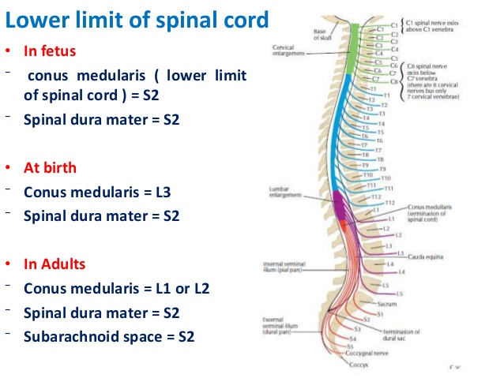
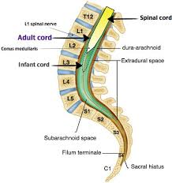
https://www.google.com/url?sa=i&url=https%3A%2F%2Fwww.slideshare.net%2FAbbasALRobaiyee1%2Fspinal-cord-anatomy-1&psig=AOvVaw2eMn7_VWDkbGgIuiIlnKoC&ust=1599987584322000&source=images&cd=vfe&ved=0CAMQjB1qFwoTCJDogbig4-sCFQAAAAAdAAAAABAX
https://www.pinterest.com/pin/429812358163386741/

Slide 12
The spinal cord is a continuation of the brainstem.
  It extends from the foramen magnum at the base of the skull to the L1/L2 vertebra where it terminates as the conus medullaris (medullary cone).
  A thin thread called filum terminale extends from the tip of the conus medullaris all the way to the 1st coccygeal vertebra (Co1) and anchors the spinal cord in place.
You can easy remember the extent of the spinal cord with a mnemonic 'SCULL', which stands for ' Spinal Cord Until L2 (LL)'.

Slide 13

Throughout its length, the spinal cord shows two well defined enlargements to accommodate for innervation of the upper and lower limbs: one at the cervical level (upper limbs), and one at the lumbosacral level (lower limbs).
http://www.myshared.ru/slide/1293602/

Slide 14
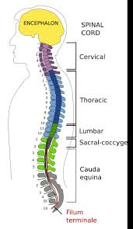
The spinal cord is divided into:
  cervical, thoracic, lumbar, and sacral regions.
(!)These regions, however, are named for the level of the vertebral column from which the spinal nerves emerge, not for the vertebrae that contain the cord itself.
Inferior to the lumbar enlargement, the cord apears to a point called the medullary cone.
  Arising from the lumbar enlargement and medullary cone is a bundle of nerve roots that occupy the vertebral canal from L2 to S5.
  This bundle, named the cauda equina for its resemblance to a horse’s tail, innervates the pelvic organs and lower limbs.
https://mmegias.webs.uvigo.es/02-english/2-organos-a/guiada_o_a_01medula.php

Slide 15
2. Identify the innervation of the spinal cord
Spinal cord regions subdivided into segments.
Although the spinal cord is not visibly segmented, the part supplied by each pair of nerves is called a segment.
• Segment – section of the spinal cord, appropriate to two couples of roots (2 anterior and 2posterior).
There are next groups of segments:
  cervical, thoracic, lumbar, sacral, and coccygeal.
Each segment of the spinal cord provides several pairs of spinal nerves, which exit from vertebral canal through the intervertebral foramina.
There are 8 pairs of cervical, 12 thoracic, 5 lumbar, 5 sacral, and 1 coccygeal pair of spinal nerves (a total of 31 pairs).

Slide 16
Divisions of spinal nerve pairs
Cervical | 8
Thoracic | 12
Lumbar | 5
Sacral | 5
Coccygeal | 1
Total | 31

Slide 17
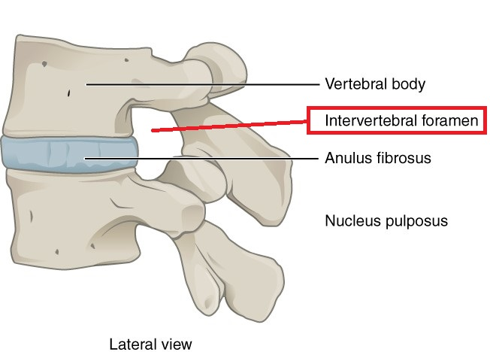
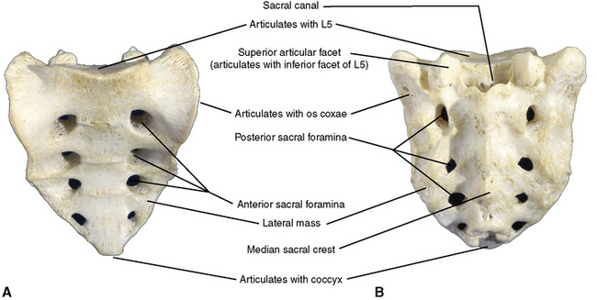
Dorsal and ventral roots enter and leave the vertebral column respectively through intervertebral foramen at the vertebral segments corresponding to the spinal segment.
The cervical spinal nerves differ from others.
  C1-C7 spinal nerves emerge from the vertebral canal above the corresponding vertebra, with an eighth pair of cervical spinal nerves emerging below the C7 vertebra, meaning there are a total of 8 pairs of cervical spinal nerves while there are only 7 cervical vertebrae.
The sacrum differs from the rest of the vertebral column in that its individual vertebrae are fused together, thus there are no intervertebral foramina. The spinal nerves instead pass through the sacral foramina.
https://radiopaedia.org/articles/intervertebral-foramen-1?lang=us
https://pocketdentistry.com/2-the-back/

Slide 18
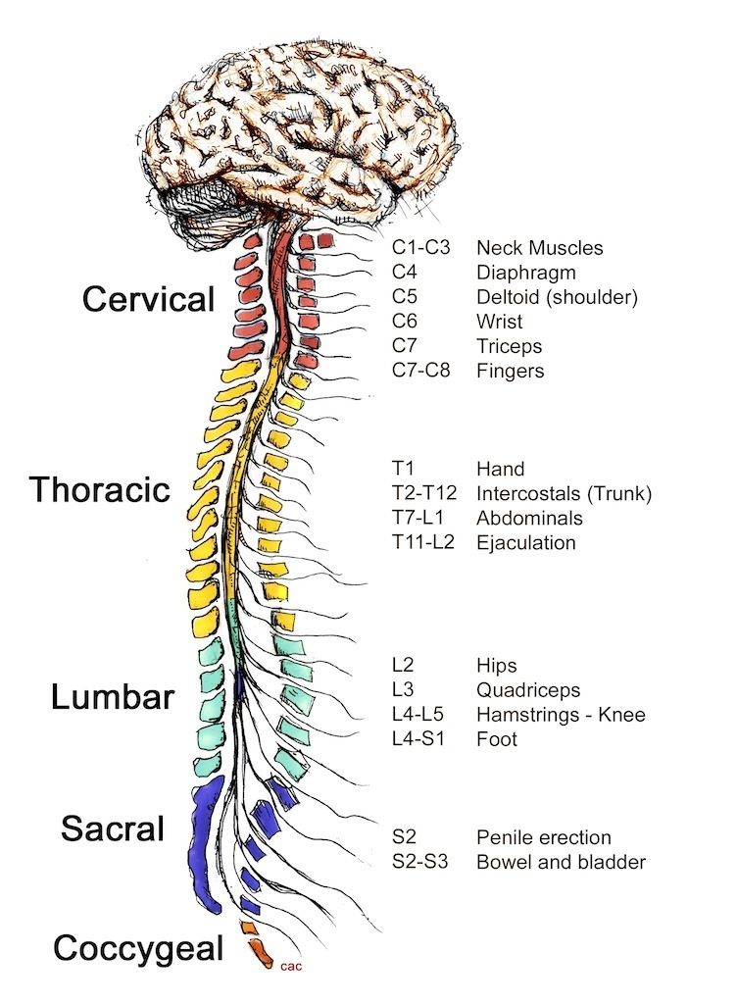
https://www.google.com/imgres?imgurl=https%3A%2F%2Fimg.go-homework.com%2Fimg%2Fbiology%2Fhow-is-the-central-nervous-system-protected-from-mechanical-damage.jpg&imgrefurl=https%3A%2F%2Fru.howtodoiteasy.com%2F71156-how-is-the-central-nervous-system-protected-from-external-and-internal-injury-26&tbnid=YokScfPtQLvCrM&vet=12ahUKEwij46z2ouPrAhWQzaYKHQeACuMQMygDegUIARCAAQ..i&docid=HSngss1iRPZ1DM&w=910&h=1239&itg=1&q=c5%20spinal%20cord%20injury&hl=ru&ved=2ahUKEwij46z2ouPrAhWQzaYKHQeACuMQMygDegUIARCAAQ

Slide 19
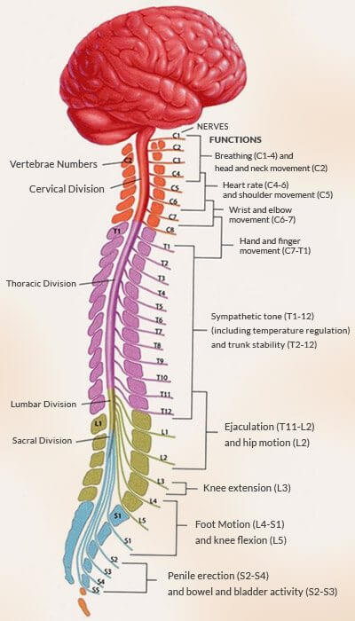
https://www.facebook.com/891812604219135/photos/d41d8cd9/2049517451781972/

Slide 20
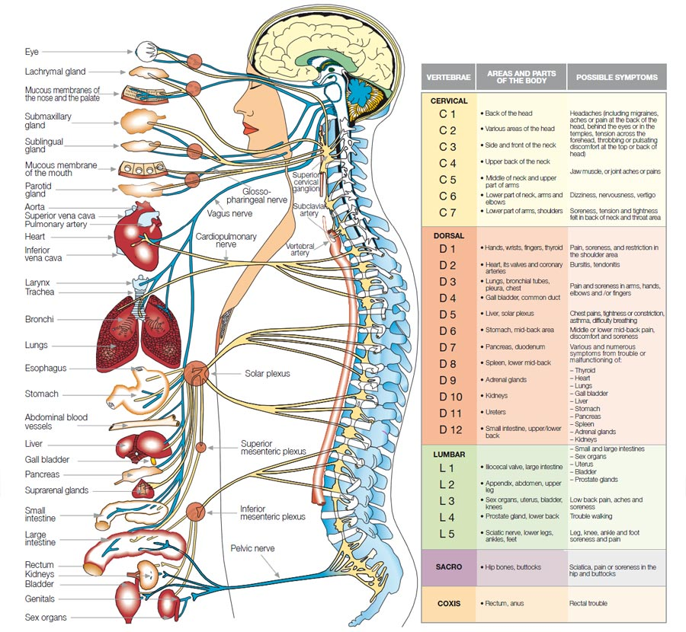
https://www.futureproofwellness.com/benefits

Slide 21
Spinal cord injuries commonly result from fractures of vertebrae C5 to C6, but never from fractures of L3 to L5.
Explain both observations.

Slide 22
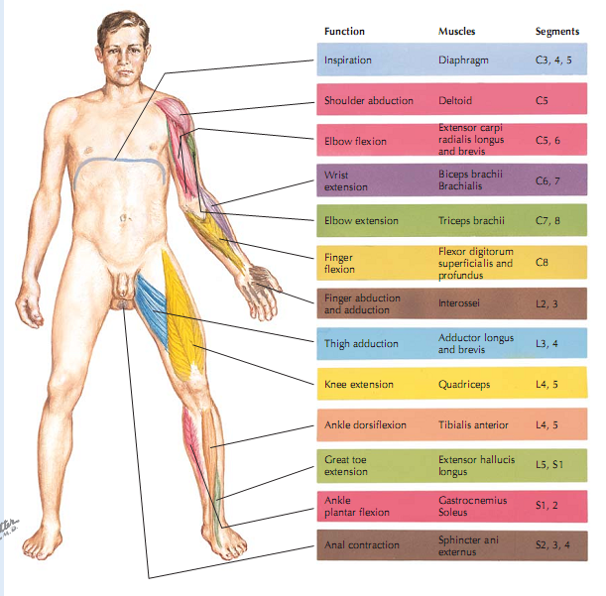
Netter’s Essential Physiology; 2009

Slide 23
3. State the three principal functions of the spinal cord
Conduction
It contains bundles of nerve fibers that conduct information up and down the cord, connecting different levels of the trunk with each other and with the brain.
  This enables sensory information to reach the brain, motor commands to reach the effectors, and input received at one level of the cord to affect output from another level.

Slide 24
2. Neural integration
Pools of spinal neurons receive input from multiple sources, integrate the information, and execute an appropriate output.
  For example, the spinal cord can integrate the stretch sensation from a full bladder with cerebral input concerning the appropriate time and place to urinate and execute control of the bladder accordingly

Slide 25
3. Locomotion
Walking involves repetitive, coordinated contractions of several muscle groups in the limbs.
  Motorneurons in the brain initiate walking and determine its speed, distance, and direction, but the simple repetitive muscle contractions that put one foot in front of another, over and over, are coordinated by groups of neurons called central pattern generators in the cord.
    These neural circuits produce the sequence of outputs to the extensor and flexor muscles that cause alternating movements of the lower limbs.

Slide 26
Plus
4. Reflexes
Spinal reflexes play vital roles in posture, motor coordination, and protective responses to pain or injury.

Slide 27
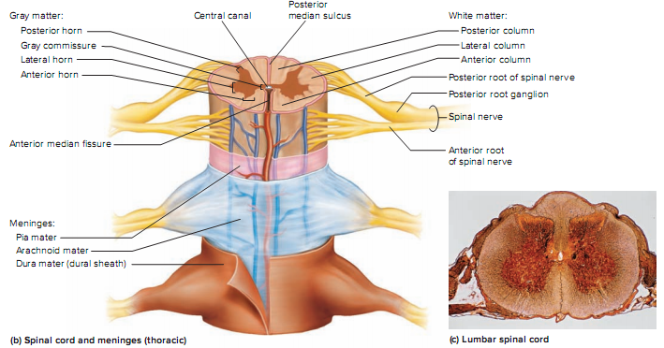
4. Describe its gross and microscopic structure
The cord exhibits longitudinal grooves on its anterior and posterior sides—the anterior median fissure and posterior median sulcus, respectively
Kenneth S. Saladin Anatomy & Physiology: The Unity of Form and Function

Slide 28
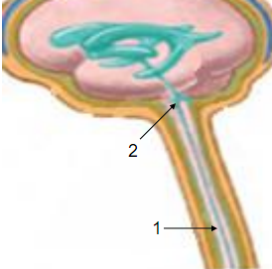
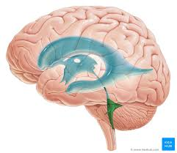
Inside the spinal cord there is a narrow cavity -central channel (1), which is full cerebrospinal fluid.
  • The upper end of it communicates with the 4th ventricle (2).
  • The lower end expands and forms a terminal ventricle.
    The terminal ventricle (ventriculus terminalis, fifth ventricle or ampulla caudalis) is the widest part of the central canal of the spinal cord that is located at or near the conus medullaris.
https://www.kenhub.com/en/library/anatomy/the-fourth-ventricle

Slide 29
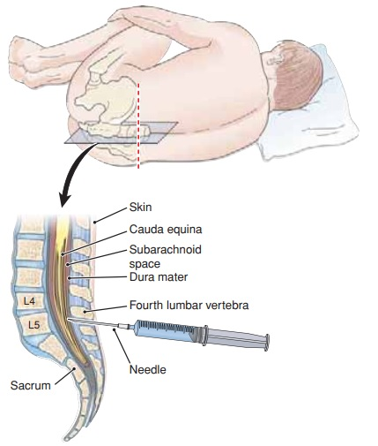
In which cases sample of CSF is needed?
When a sample of CSF is needed for clinical purposes, it is taken from the lumbar cistern by a procedure called lumbar puncture (or colloquially, spinal tap).
  A spinal needle is inserted between two vertebrae at level L3/L4 or L4/L5, where there is no risk of accidental injury to the spinal cord (which ends at L1 to L2).
  CSF drips from the spinal needle into a collection tube; usually 3 to 4 mL of CSF is collected
https://www.tuyenlab.net/2018/02/haematology-cerebrospinal-fluid.html

Slide 30
Meninges of the Spinal Cord
The spinal cord and brain are enclosed in three fibrous membranes called:
  meninges - singular, meninx .
  These membranes separate the soft tissue of the central nervous system from the bones of the vertebrae and skull.
  From superficial to deep, they are the dura mater, arachnoid mater, and pia mater.
The dura mater forms a loose-fitting sleeve called the dural sheath around the spinal cord.
  It is a tough membrane about as thick as a rubber kitchen glove, composed of multiple layers of dense irregular connective tissue.
  The space between the sheath and vertebral bones, called the epidural space, is occupied by blood vessels, adipose tissue, and loose connective tissue.

Slide 31
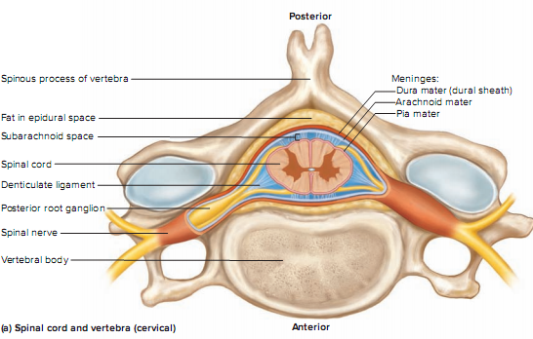

Slide 32
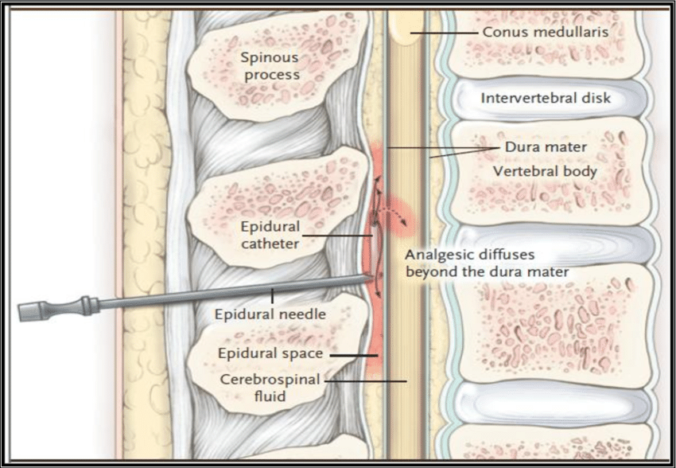
Anesthetics are sometimes introduced to this space to block pain signals during childbirth or surgery; this procedure is called epidural anesthesia.
https://www.researchgate.net/figure/Fig-4-Epidural-anesthesia-technique-113_fig3_286937858

Slide 33
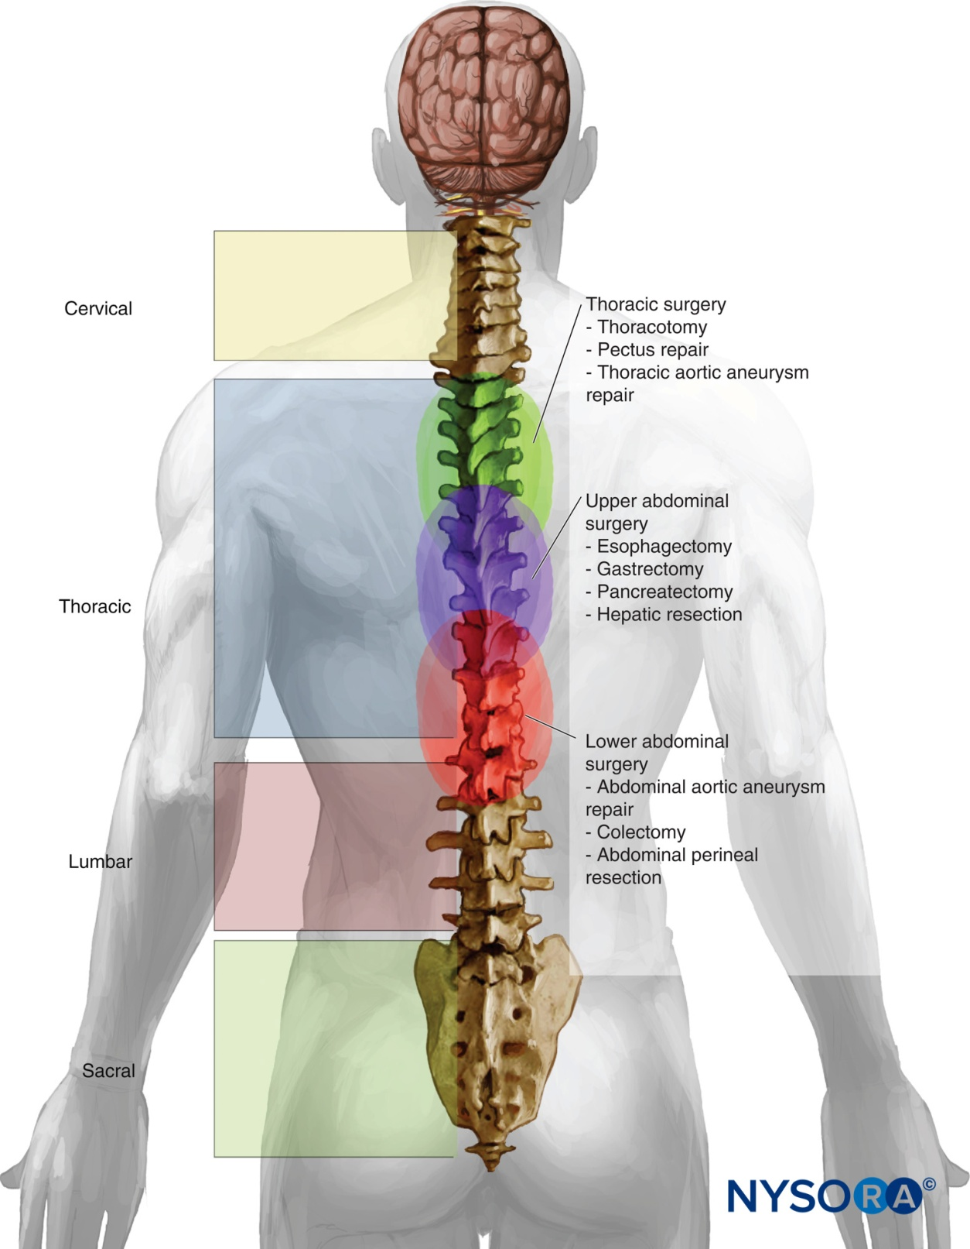
Notes:
https://www.google.com/imgres?imgurl=https%3A%2F%2Fwww.nysora.com%2Fwp-content%2Fuploads%2F2018%2F09%2F24x01.jpg&imgrefurl=https%3A%2F%2Fwww.nysora.com%2Fregional-anesthesia-for-specific-surgical-procedures%2Fabdomen%2Fepidural-anesthesia-analgesia%2F&tbnid=4lEHgHwyFLaMVM&vet=12ahUKEwjd4-LNpePrAhUEf5oKHXacClwQMygCegUIARCWAQ..i&docid=I57Q8Ff_xxZihM&w=1555&h=2000&q=epidural%20analgesia%20&hl=ru&ved=2ahUKEwjd4-LNpePrAhUEf5oKHXacClwQMygCegUIARCWAQ

Slide 34
The arachnoid mater consists of the
  arachnoid membrane— five or six layers of squamous to cuboidal cells adhering to the inside of the dura—
  and a looser array of cells and collagenous and elastic fibers spanning the gap between the arachnoid membrane and the pia mater.
    This gap, the subarachnoid space, is filled with cerebrospinal fluid (CSF). Inferior to the medullary cone, the subarachnoid space is called the lumbar cistern and is occupied by the cauda equina and CSF.

Slide 35
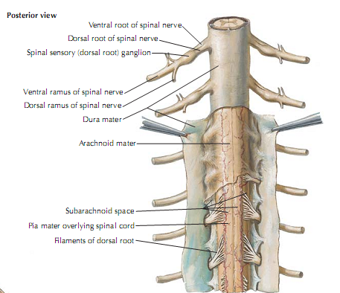
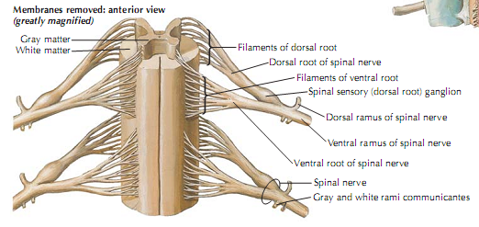
Netter’s Essential Physiology; 2009

Slide 36
The pia mater is a delicate, transparent membrane composed of one or two layers of squamous to cuboidal cells and delicate collagenous and elastic fibers.
  It closely follows the contours of the spinal cord.
  It continues beyond the medullary cone as a fibrous strand, the terminal filum, within the lumbar cistern.
At the level of vertebra S2, it exits the lower end of the cistern and fuses with the dura mater, and the two form a coccygeal ligament that anchors the cord and meninges to vertebra Co1.
  At regular intervals along the cord, extensions of the pia called denticulate ligaments extend through the arachnoid to the dura, anchoring the cord and limiting side-to-side movements.

Slide 37
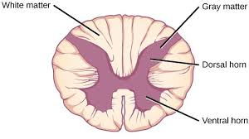
Cross-Sectional Anatomy
The spinal cord, like the brain, consists of two kinds of nervous tissue called gray and white matter.
Gray matter
  has a relatively dull color because it contains little myelin.
  It contains the somas, dendrites, and proximal parts of the axons of neurons.
  It is the site of synaptic contact between neurons, and therefore the site of all neural integration in the spinal cord.
White matter, by contrast,
  has a bright, pearly white appearance due to an abundance of myelin.
  It is composed of bundles of axons, called tracts, that carry signals from one level of the CNS to another.
Both gray and white matter also have an abundance of glial cells.
https://biomedgrid.com/fulltext/volume5/the-evolution-of-the-nervous-system-invertebrates-vs-vertebrates-a-useful-instrument.000960.php

Slide 38
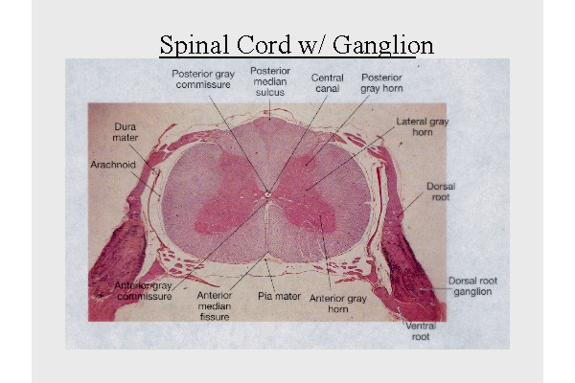
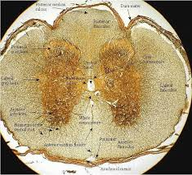
Nervous tissue is often histologically stained with silver compounds, which give the gray matter a brown or golden color and white matter a lighter tan to amber color.
https://www.pinterest.com/pin/521080619362459888/
http://anatomiahumanaust2012.blogspot.com/2012/11/

Slide 39
Gray Matter
The spinal cord has a central core of gray matter that looks some what butterfly- or H-shaped in cross sections.
  The core consists mainly of two posterior (dorsal) horns , which extend toward the posterolateral surfaces of the cord,
  and two thicker anterior (ventral) horns, which extend toward the anterolateral surfaces .
The right and left sides of the gray matter are connected by a median bridge called the gray commissure.
  In the middle of the commissure is the central canal, which is collapsed in most areas of the adult spinal cord, but in some places (and in young children) remains open, lined with ependymal cells, and filled with CSF.

Slide 40
The posterior horn receives sensory nerve fibers from the spinal nerves, which usually synapse with networks of interneurons in the horn.
The anterior horn contains the large neurosomas of motor neurons whose axons lead out to the skeletal muscles.

Slide 41
The interneurons and motor neurons are especially abundant in the cervical and lumbar enlargements and are quite conspicuous in histological sections from these levels.
  The high density of neurons in these regions is related to motor control and sensation in the upper and lower limbs.
An additional lateral horn is visible on each side of the gray matter from segments T2 through L1 of the cord.
  It contains neurons of the sympathetic nervous system, which send their axons out of the cord by way of the anterior root along with the somatic efferent fibers.

Slide 42
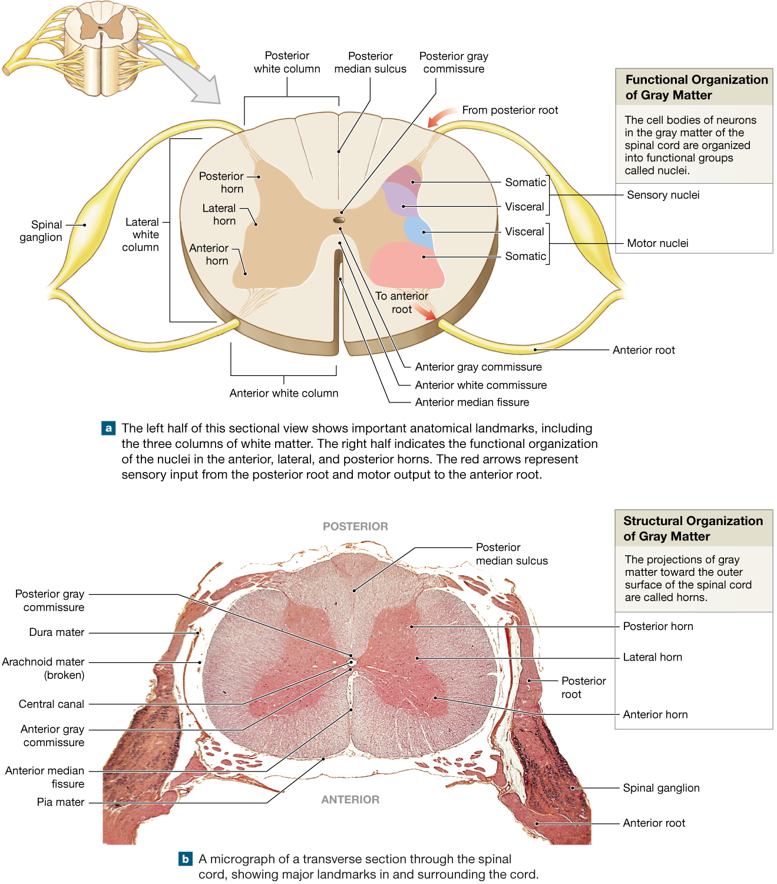
https://www.pinterest.co.kr/pin/783344928915179217/

Slide 43
What will be if we cut anterior horn?
Posterior?

Slide 44
The functions of the spinal roots were found out using cutting methods and irritation.
Prominent Scottish Anatomist and physiologist Bell and French researcher Magendie found that if he one-sided cut the anterior spinal roots there would be paralysis of the limbs on the same side, sensitivity remains completely.
Cutting the posterior roots results in the loss of sensation, motor function is retained.

Slide 45
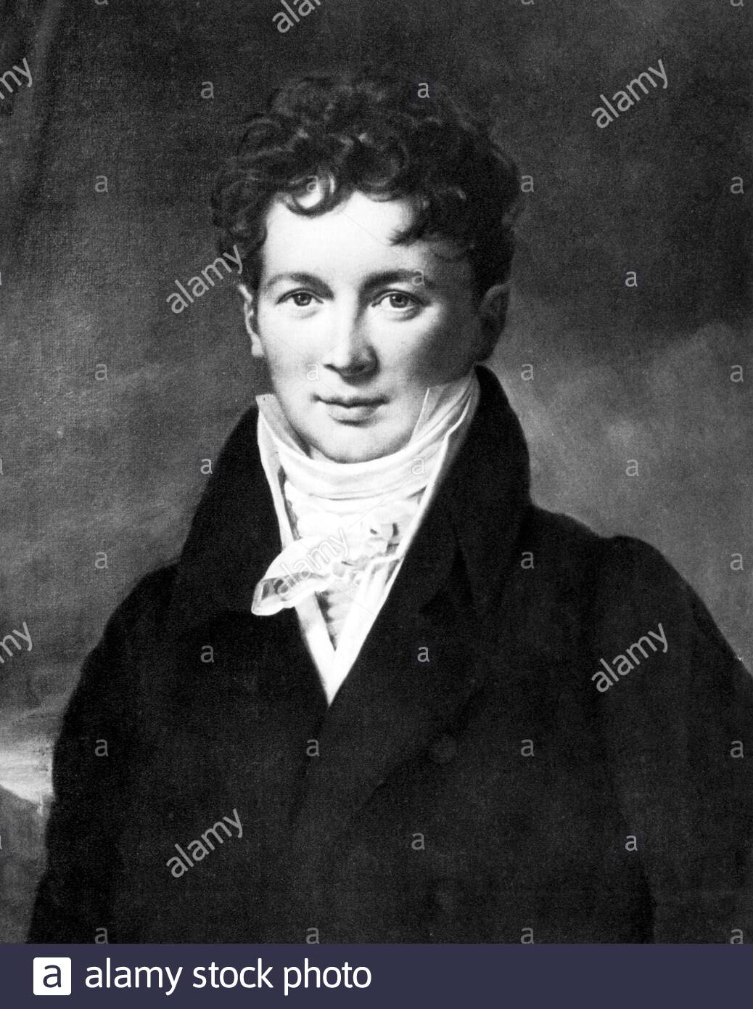
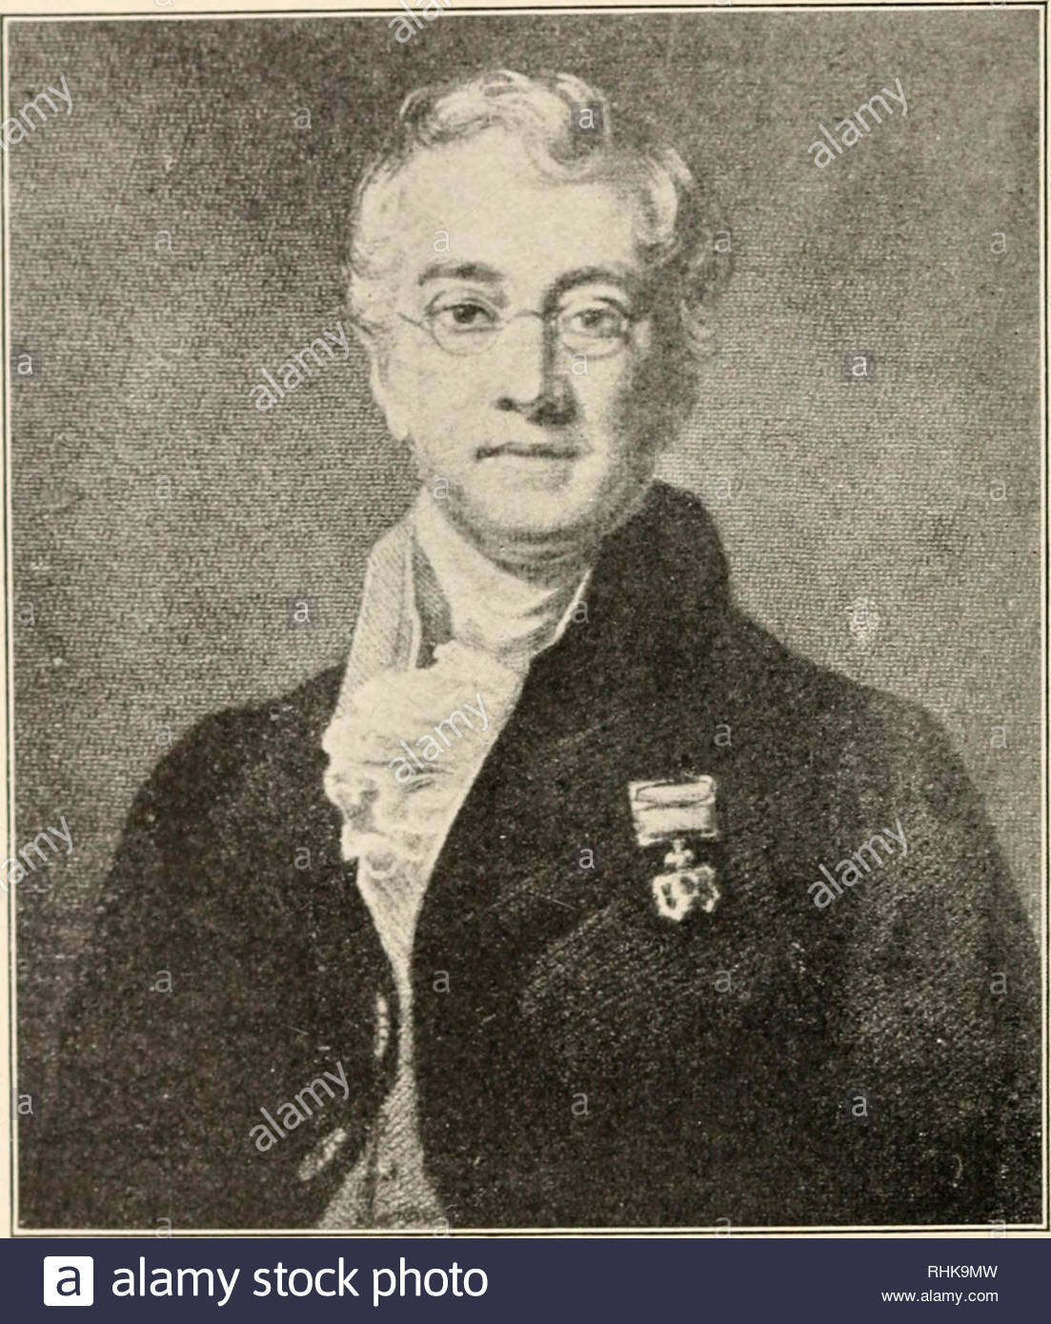
François Magendie (1783-1855)
Charles Bell (1774-1842)
Notes:
https://www.alamy.com/magendie-portrait-by-paulin-jean-baptiste-gurin-franois-magendie-1783-1855-was-a-french-physiologist-considered-a-pioneer-of-experimental-physiology-he-conducted-a-number-of-experiments-on-the-nervous-system-in-particular-verifying-the-differentiation-between-sensory-and-motor-nerves-in-the-spinal-cord-the-bell-magendie-law-the-english-claimed-that-bell-published-his-discoveries-first-and-that-magendie-stole-his-experiments-magendie-was-a-notorious-vivisector-shocking-even-many-of-his-contemporaries-with-the-live-dissections-that-he-performed-at-public-lectures-in-physiology-he-wa-image352825529.html

Slide 46
Thus, it was shown that afferent impulses enter spinal cord through the posterior roots(sensitive), efferent impulses come out through the anterior roots(motor).

Slide 47
White Matter
The white matter of the spinal cord surrounds the gray matter.
  It consists of bundles of axons that course up and down the cord and provide avenues of communication between different levels of the CNS.
These bundles are arranged in three pairs called columns or funiculi—
  a posterior (dorsal),
  lateral,
  and anterior (ventral) column on each side.
  Each column consists of subdivisions called tracts or fasciculi.

Slide 48
5. Trace the pathways followed by nerve signals travelling up and down the spinal cord
Spinal Tracts
Knowledge of the locations and functions of the spinal tracts is essential in diagnosing and managing spinal cord injuries.
Spinal cord neural pathways are found within the spinal cord white matter.
  As we said before on the each side, the white matter is divided into three funiculi: anterior, lateral, and posterior.
Ascending tracts convey information from the periphery to the brain.
Descending tracts carry information from the brain to the periphery.
The spinal cord is more than just a conduit, as it also modifies and integrates the information that pass through it.

Slide 49
All nerve fibers in a given tract have a similar origin, destination, and function.
Many of these fibers have their origin or destination in a region called the brainstem.

Slide 50
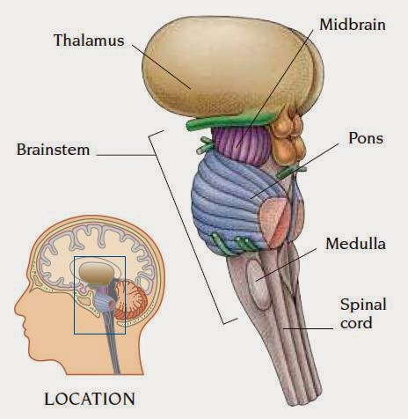
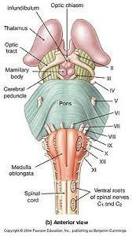
Brainstem is a vertical stalk that supports the large cerebellum at the rear of the head and, even larger, two cerebral hemispheres that dominate the brain.
https://www.pinterest.com/pin/621426448570663400/

Slide 51
Several of these tracts undergo decussation as they pass up or down the brainstem and spinal cord— meaning that they cross over from the left side of the body to the right, or vice versa.
  As a result, the left side of the brain receives sensory information from the right side of the body and sends motor commands to that side,
  while the right side of the brain senses and controls the left side of the body.
  Therefore, a stroke that damages motor centers of the right side of the brain can cause paralysis of the left limbs and vice versa.

Slide 52
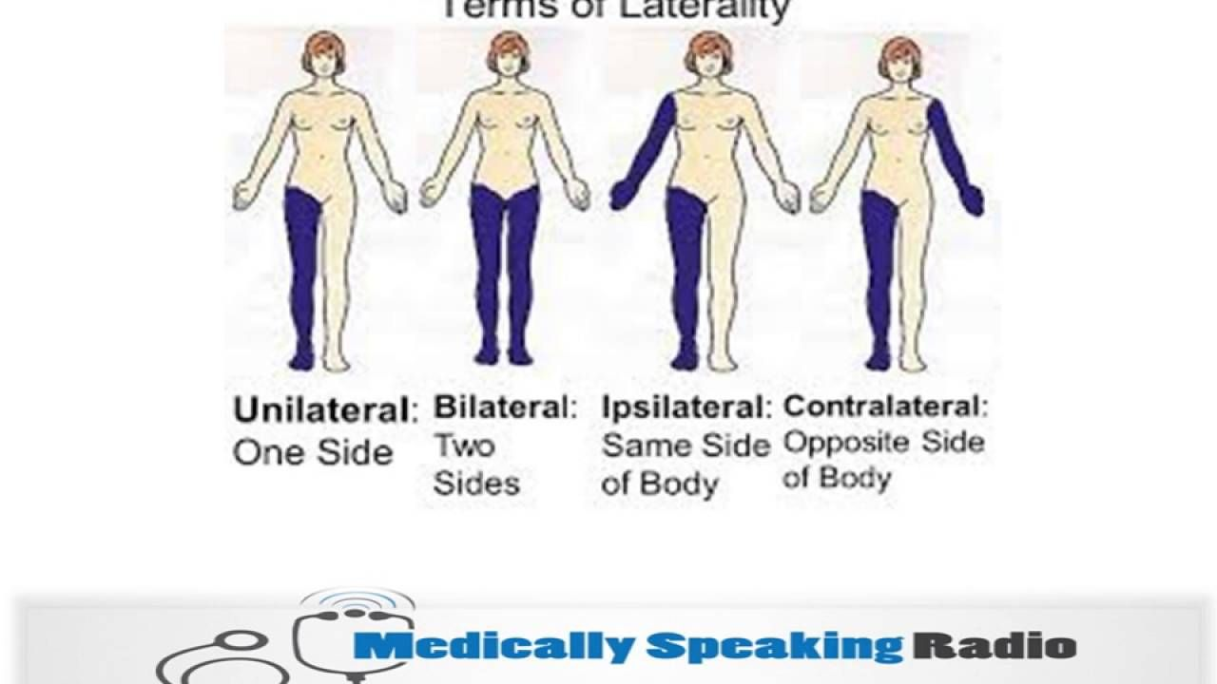
When the origin and destination of a tract are on opposite sides of the body, we say they are contralateral to each other.
When a tract does not decussate, its origin and destination are on the same side of the body and we say they are ipsilateral.
https://www.pinterest.com.mx/pin/784400460082586499/

Slide 53
Ascending Tracts
Ascending tracts carry sensory signals up the spinal cord.
Sensory signals typically travel across three neurons from their origin in the receptors to their destination in the brain:
  a first-order neuron that detects a stimulus and transmits a signal to the spinal cord or brainstem;
  a second-order neuron that continues as far as a “gateway” called the thalamus at the upper end of the brainstem;
  and a third-order neuron that carries the signal the rest of the way to the cerebral cortex.
The axons of these neurons are called the first- through third-order nerve fibers
The names of most of them consist of the prefix spino- followed by a root denoting the destination of its fibers in the brain

Slide 54
The major ascending tracts
The gracile fasciculus carries signals from the midthoracic and lower parts of the body.
  Below vertebra T6, it composes the entire posterior column.
  At T6, it is joined by the cuneate fasciculus.
  It consists of first-order nerve fibers that travel up the ipsilateral side of the spinal cord and terminate at the gracile nucleus in the medulla oblongata of the brainstem.
  These fibers carry signals for vibration, visceral pain, deep and discriminative touch (touch whose location one can precisely identify), and especially proprioception from the lower limbs and lower trunk.
Proprioception is the nonvisual sense of the position and movements of the body.

Slide 55
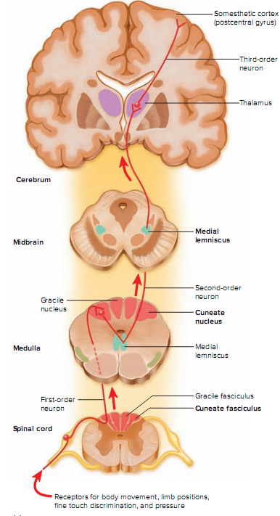

Slide 56
The cuneate fasciculus joins the gracile fasciculus at the T6 level.
It occupies the lateral portion of the posterior column and forces the gracile fasciculus medially.
It carries the same type of sensory signals, originating from T6 and up (from the upper limbs brainstem to the thalamus).
  Third-order fibers go from the thalamus to the cerebral cortex.
  Because of decussation, the signals carried by the gracile and cuneate fasciculi ultimately go to the contralateral cerebral hemisphere.

Slide 57
The spinothalamic tract and some smaller tracts form the anterolateral system, which passes up the anterior and lateral columns of the spinal cord.
The spinothalamic tract carries signals for pain, temperature, pressure, tickle, itch, and light or crude touch.
  Light touch is the sensation produced by stroking hairless skin with a feather or cotton wisp, without indenting the skin;
  crude touch is touch whose location one can only vaguely identify.
In this pathway,
  first-order neurons end in the posterior horn of the spinal cord near the point of entry.
  Here they synapse with second-order neurons, which decussate and form the contralateral ascending spinothalamic tract. These fibers lead all the way to the thalamus.
  Third-order neurons continue from there to the cerebral cortex.
Because of decussation, sensory signals in this tract arrive in the cerebral hemisphere contralateral to their point of origin.

Slide 58
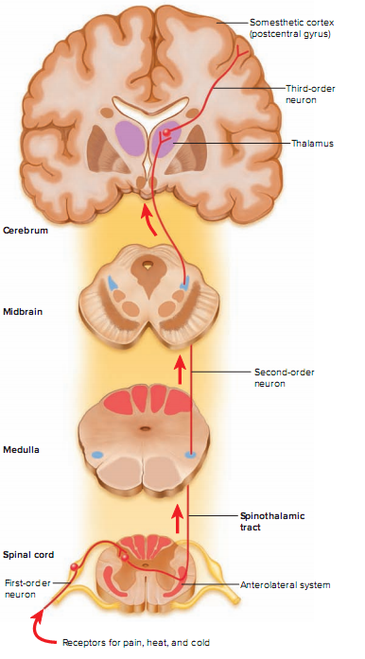

Slide 59
The spinoreticular tract also travels up the anterolateral system.
  It carries pain signals resulting from tissue injury, as will be discussed later in “Projection Pathways for Pain” .
  The first-order sensory neurons enter the posterior horn
  and immediately synapse with second-order neurons. These decussate to the opposite anterolateral system, ascend the cord, and end in a loosely organized core of gray matter called the reticular formation in the medulla and pons.
  Third-order neurons continue from the pons to the thalamus, and fourth-order neurons complete the path from there to the cerebral cortex.

Slide 60
The posterior and anterior spinocerebellar tracts travel through the lateral column and carry proprioceptive signals from the limbs and trunk to the cerebellum at the rear of the brain.
  Their first-order neurons originate in muscles and tendons and end in the posterior horn of the spinal cord.
  Second-order neurons send their fibers up the spinocerebellar tracts and end in the cerebellum.
Fibers of the posterior tract travel up the ipsilateral side of the spinal cord.
  Those of the anterior tract cross over and travel up the contralateral side but then cross back in the brainstem to enter the ipsilateral side of the cerebellum.
Both tracts provide the cerebellum with feedback needed to coordinate muscle action

Slide 62
Descending Tracts
Descending tracts carry motor signals down the brainstem and spinal cord.
A descending motor pathway typically involves two neurons called the upper and lower motor neurons.
  The upper motor neuron begins with a soma in the cerebral cortex or brainstem and has an axon that terminates on a lower motor neuron in the brainstem or spinal cord.
  The axon of the lower motor neuron then leads the rest of the way to the muscle or other target organ.
The names of most descending tracts consist of a word root denoting the point of origin in the brain, followed by the suffix -spinal.

Slide 63
The corticospinal tracts carry motor signals from the cerebral cortex for precise, finely coordinated limb movements.
The fibers of this system form ridges called pyramids on the anterior surface of the medulla oblongata, so these tracts were once called pyramidal tracts.
  Most corticospinal fibers decussate in the lower medulla and form the lateral corticospinal tract on the contralateral side of the spinal cord.
  A few fibers remain uncrossed and form the anterior corticospinal tract on the ipsilateral side.
Fibers of the anterior tract decussate lower in the cord, however, so even they control contralateral muscles.
  This tract gets smaller as it descends and gives off nerve fibers, and usually disappears by the midthoracic level.

Slide 64
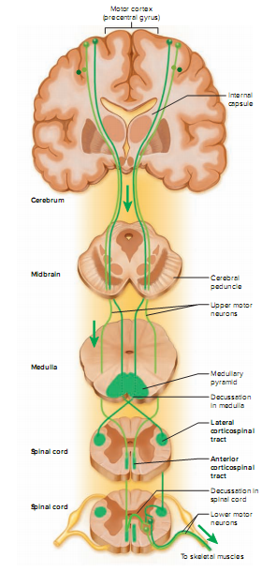


Slide 65
The tectospinal tract begins in a midbrain region called the tectum and crosses to the contralateral side of the midbrain.
  It descends through the brainstem to the upper spinal cord on that side, going only as far as the neck.
  It is involved in reflex turning of the head, especially in response to sights and sounds.

Slide 66
The lateral and medial reticulospinal tracts originate in the reticular formation of the brainstem.
  They control muscles of the upper and lower limbs, especially to maintain posture and balance.
  They also contain descending analgesic pathways that reduce the transmission of pain signals to the brain

Slide 67
The lateral and medial vestibulospinal tracts begin in the brainstem vestibular nuclei, which receive signals for balance from the inner ear.
The lateral vestibulospinal tract passes down the anterior column of the spinal cord and facilitates neurons that control extensor muscles of the limbs, thus inducing the limbs to stiffen and straighten.
  This is an important reflex in responding to body tilt and keeping one’s balance.
The medial vestibulospinal tract splits into ipsilateral and contralateral fibers that descend through the anterior column on both sides of the cord and terminate in the neck.
  It plays a role in the control of head position.

Slide 68
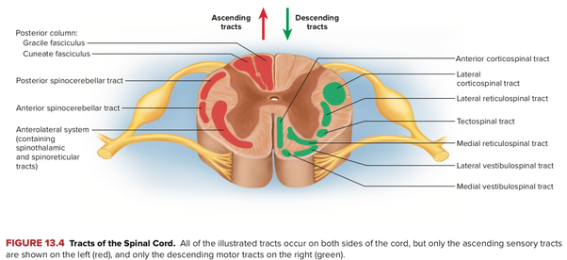

Slide 69
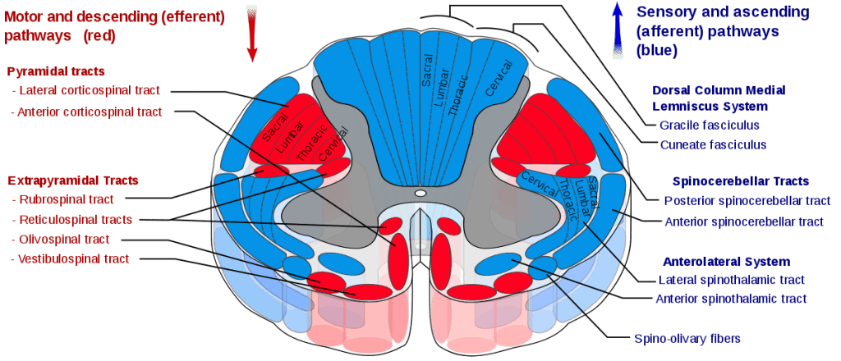
https://www.pinterest.com/pin/398005685816014445/

Slide 70
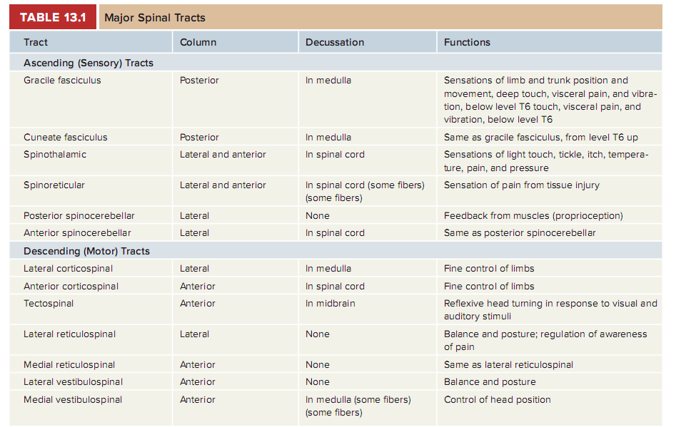

Slide 71
Anterior funiculus | Ascending tract: - Anterior spinothalamic tract Descending tracts: - Anterior corticospinal tract - Vestibulospinal tract - Tectospinal tract - Reticulospinal tract
Lateral funiculus | Ascending tracts: - Posterior spinocerebellar tract - Anterior spinocerebellar tract - Lateral spinothalamic tract - Spinotectal tract - Posterolateral tract of Lissauer - Spinoreticular tract - Spino-olivary tract Descending tracts: - Lateral corticospinal tract - Rubrospinal tract - Lateral reticulospinal tract - Descending autonomic tracts - Olivospinal tract
Posterior funiculus | Ascending tracts: - Gracile fasciculus of Gol - Cuneate fasciculus of Burdach

